Slide 1
Project X Business Performance Analysis Report
August 24, 2023

Slide 2

By Group One
Adetutu Adejuyigbe – DA (Team Lead)
Deborah Tolulope Jesusolu-Enioluwalafe - DA
Faith Bello - DA
Obiora Kenechukwu - DA
Ayomide Oladele -HRA
Oghenekaro Ogon – HRA

Slide 3
Introduction
In today's digital era, data speaks volumes, and it is on this premise Project X has decided to be intentional with her data trends and patterns.
Project X is rapidly establishing itself as a dynamic educational system, dedicated to delivering unparalleled customer satisfaction on a global scale while simultaneously optimizing operational efficiency.
From the data gathered from Project X (24th December 2022 to 4th August 2023), we provided valuable insights into customer interactions with the company's products across diverse locations using a meticulous data evaluation process, which encompasses data cleaning and visualization techniques.
It is pertinent to note that the data collect was in both Naira (NGN) and Great British Pound (GBP) which was solely converted to Great British Pound (GBP) using the exchange rate found in https://www.exchange-rates.org/exchange-rate-history/gbp-ngn-2023.
This comprehensive analysis stands as a foundational element in our pursuit of gaining a profound understanding of Project X's performance.

Slide 4
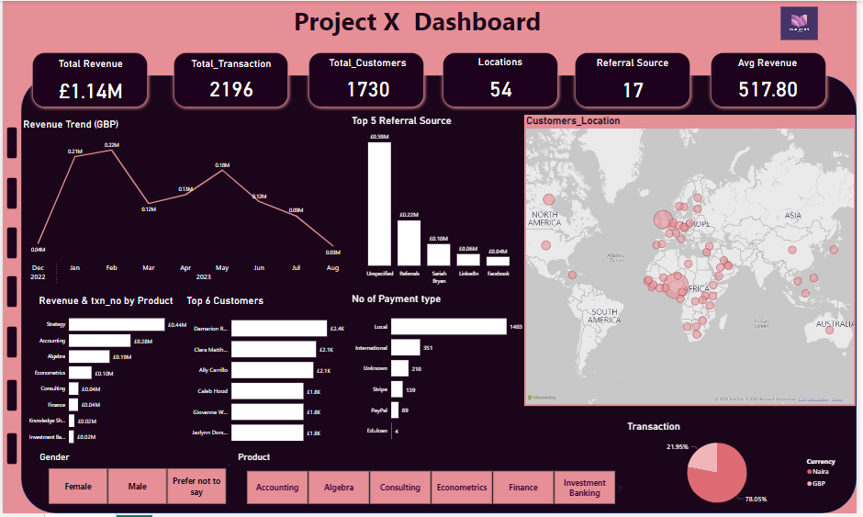

Slide 5
Revenue Trend For The Period In View
Total number of transaction was 2,196
Total revenue was around £1.14 million
February 2023 stood out with the highest revenue, reaching roughly £222k.
Notably, August recorded the lowest revenue, around £30k, but this can be attributed to the fact that its data collection spanned only half a month.
If the current business trend for "Project X" persists, the average sales projection for the remaining 2023 ranges approximately between £90 and £710.
However, it's important to recognize that this projection might undergo adjustments due to factors beyond our control and other variables.

Slide 6
Quarterly Performance
The first quarter amounted to about £546k and the transaction count of 1,060.
The second quarter had a decline of about £434k with the transaction count of 784.
The third quarter which is still ongoing had a total of £122k with the transaction count of 295.

Slide 7
Product Performance
'Strategy' is the most popular product amongst all the 8 categories of products, with 803 transactions and revenue amounting to approximately £437k.
'Accounting' follows closely behind with 524 transactions, showing its significant presence with revenue amounting to approximately £281k.
'Knowledge Sharing’ recorded the lowest transaction count at 49, resulting in revenue totaling approximately £25k. Interestingly, 'Investment Banking,' despite having 64 transactions, generated a comparably lower revenue of around £22k. This suggests there's room for improvement within this category.

Slide 8
Customer’s Behavior
Based on our analysis, we've identified a total customer count of 1,730. Among these, the male demographic constitutes the largest share at approximately 53%, followed closely by females at approximately 47%. The "preferred not to say" category comprises the smallest segment, accounting for about 0.17% of the total.
In assessing the impact of referral sources, it's intriguing to note that a substantial portion of customers, 1,153 in total, generated £590k in sales without specifying whether they were referred or not. On the other hand, customers who indicated that they were referred accounted for £216k in sales. Notably, Sariah Bryan played a significant role as a referral source, contributing a total of £103k in sales.

Slide 9
Location
We observed that among our diverse customer base spread across the globe, the three leading countries in terms of customer numbers are Nigeria, followed by the United Kingdom, and then Canada, ranked in descending order. These three countries have customer counts of 822, 511, and 156, respectively.
The revenue generated by customers in Nigeria, the United Kingdom, and Canada collectively comprises around 84.9% of the total revenue, indicating their substantial contribution to our overall financial performance compared to customers from other locations.

Slide 10
Type and mode of payment
The local payment method stands out as the most favored option, representing the highest transaction volume with 1,403 instances.
International payment method had a total of 351 transactions.
The Eduloan payment method exhibited the lowest with 4 transactions.
Shifting our focus to the distribution of transaction currencies. The Naira takes the lead as the dominant currency, being the choice for approximately 78.05% of all transactions. The remaining transactions were in pounds, contributing to roughly 21.95% of the total transaction . This currency distribution insight provides valuable understanding into the currency preferences of our customers.

Slide 11
Data Integrity Note
It's important to highlight that in our pursuit of accurate analysis, we removed three transactions amounting to £1,134 from consideration. These transactions lacked clear location data, which could have potentially skewed the results.

Slide 12
Recommendation
Capitalize on the success observed in February, our highest sales month. Devote resources and marketing efforts to identify what factors contributed to this success and replicate them in other months.
We should focus on making our best-selling products even better while improving those that aren't performing as well.
Leverage the observed patterns in weekday purchasing. Strategically plan promotions and campaigns, to enhance sales on these high-performing days.
Developed an enhanced referral program prompting customers to specify sources, driving revenue. Sariah Bryan's exceptional referrals highlight potential; planning joint marketing efforts and tailored rewards to further collaboration. This strategy aims to boost revenue while nurturing high-value partnerships.
Strategically plan initiatives to mitigate the lower sales months, such as August. Consider running targeted campaigns or offering unique incentives during these periods to boost customer engagement.

Slide 13
Recommendation Cont.…
Diversifying campaigns to target genders beyond males, potentially boosting their revenue generation..
Address the issue of missing location data for transactions. Implement measures to ensure all transaction data is complete and accurate, as missing data can lead to distorted analysis and decision-making.
Additionally, nurturing relationships in our top countries like Nigeria, the UK, and Canada is crucial, and we should also investigate expanding into new regions.
It's essential to adjust our strategies in response to how our revenues are changing and what we predict for sales in the future.
When it comes to payments, we should make sure both local and international options are user-friendly, and understanding what currencies our customers prefer can guide our communication efforts.

Slide 14
Thank You!

